Slide 2
Performing the actual UNCERTAINTY PROPAGATION ANALYSIS
Taylor series approximation method
Monte Carlo method
Advantages Monte Carlo method:
Yields the full output pdf, not only the mean and variance
Works with any model
Easy to implement

Slide 3
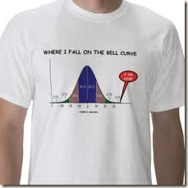
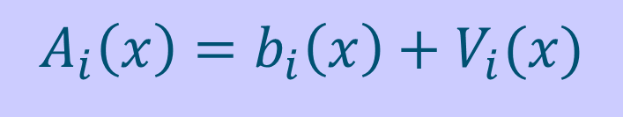
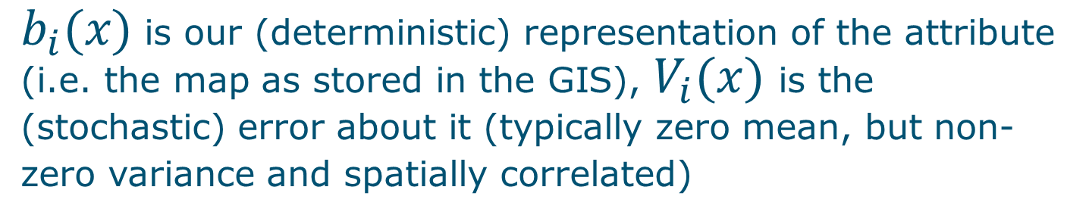
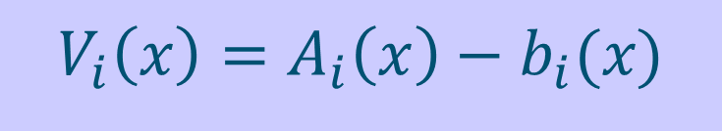
1. DEFINITION of the uncertainty model (concentrate on continuous-numerical attributes)
$$A_{i}\left(x\right)=b_{i}\left(x\right)+V_{i}(x)$$
$b_{i}(x)$ is our (deterministic) representation of the attribute (i.e. the map as stored in the GIS), $V_{i}(x)$ is the (stochastic) error about it (typically zero mean, but non-zero variance and spatially correlated)
Error is difference between reality and our representation of reality:
$$V_{i}\left(x\right)=A_{i}\left(x\right)−b_{i}(x)$$

Slide 4
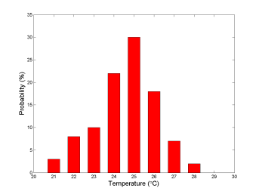
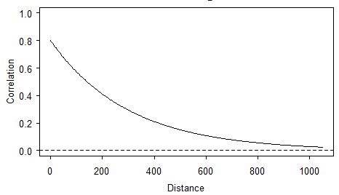

Statistical model of $V_{i}(x)$ must include:
Marginal pdf at each location (both its shape and parameters)
Spatial correlation (correlogram or semivariogram)
Temporal correlation (for dynamic variables)
Cross-correlation with other uncertain inputs

Slide 5

2. IDENTIFICATION of the uncertainty model
Measurement error from instrument and lab specifications, or by taking replicates (always let laboratories analyse duplicates, without telling them!)
Sampling error using sampling theory from statistics (e.g. standard error of the mean, confidence intervals)
Use of ground truth verification data (e.g. control points)
Interpolation error using geostatistics (kriging)
Errors in transfer functions such as regression: R-square
Classification error using multivariate statistics (e.g. maximum likelihood classification remote sensing imagery)
Expert judgement or Expert elicitation (last resort?)
In practice, this may well be the most difficult step of the entire uncertainty propagation analysis

Slide 6
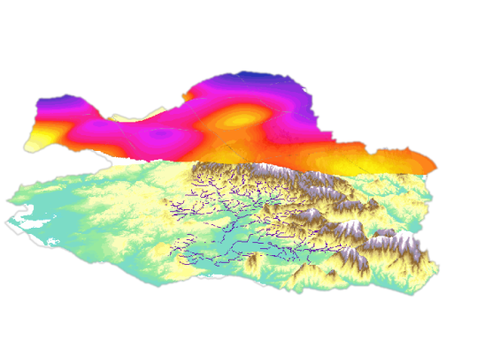
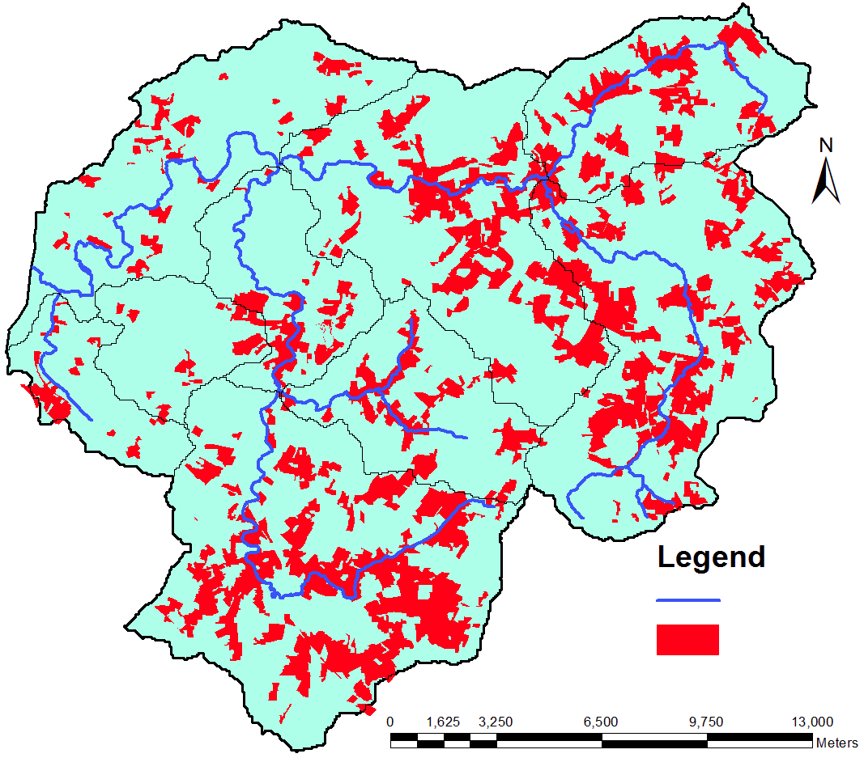
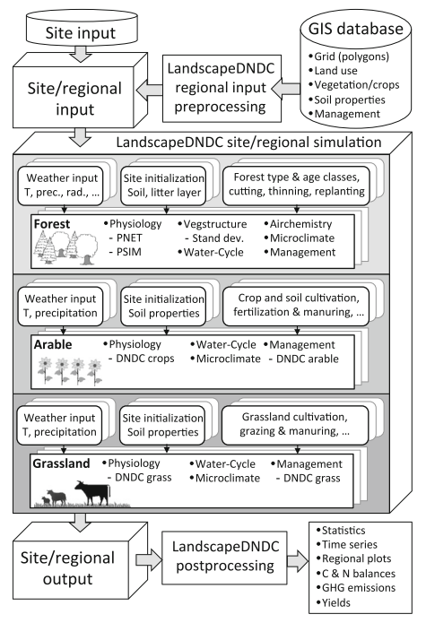
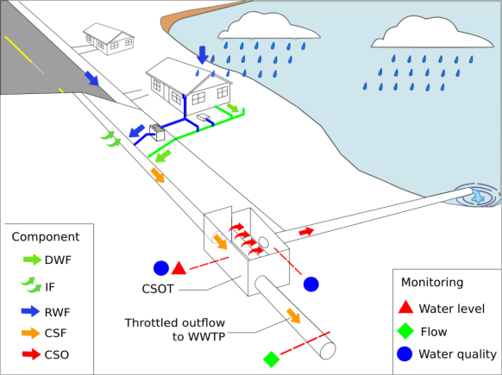
Potential applications
Pollution models (here, Metaldehyde Prediction Model)
Biogeochemical models (here, process-based model LandscapeDNDC
Risk map
Urban drainage models
Haas et. al. (2013)
Notes:
Now, probably the most interesting thing for you is that the ‘spup’ package would also have a potential for use in industry. It could be used for models like you’ve seen at earlier presentations, e.g. MiStat presented by Arturo, or wastewater treatment plant models, or other.

Slide 7
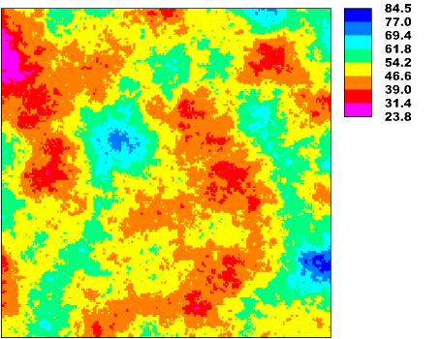
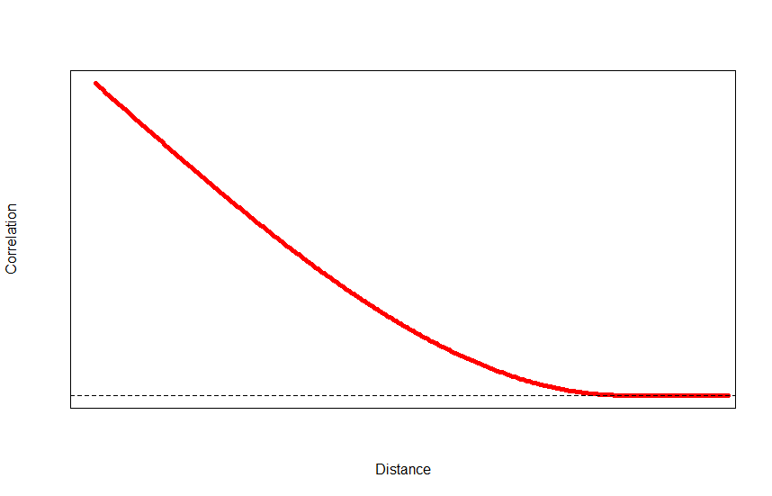
Why is it important to include spatial correlation?
Example 1: a possible ‘reality’
1.0
Correlation
Distance

Slide 8
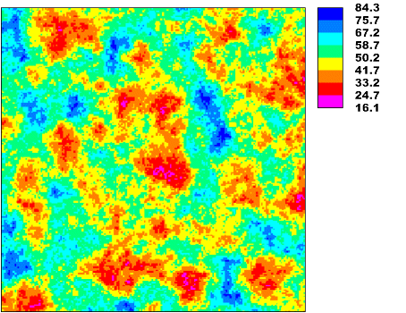
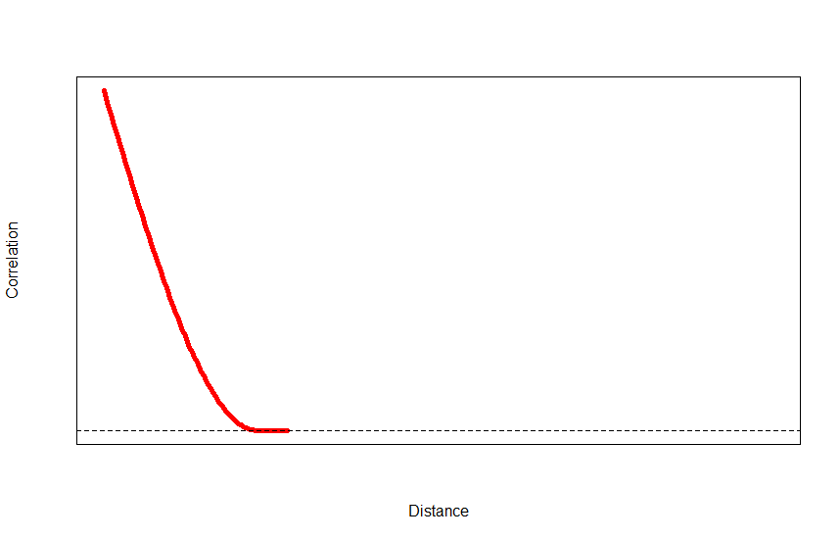
Why is it important to include spatial correlation?
Example 2: second reality
1.0
Correlation
Distance

Slide 9
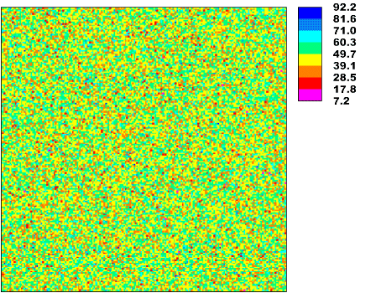
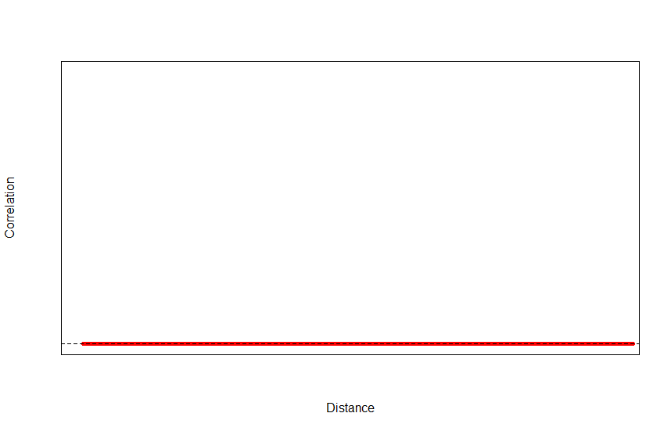
Why is it important to include spatial correlation?
Example 3: third reality
Correlation
0
Distance

Slide 10
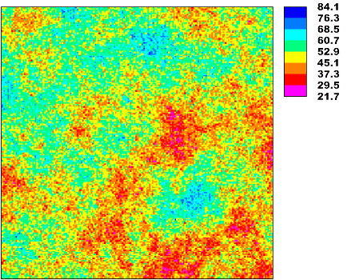
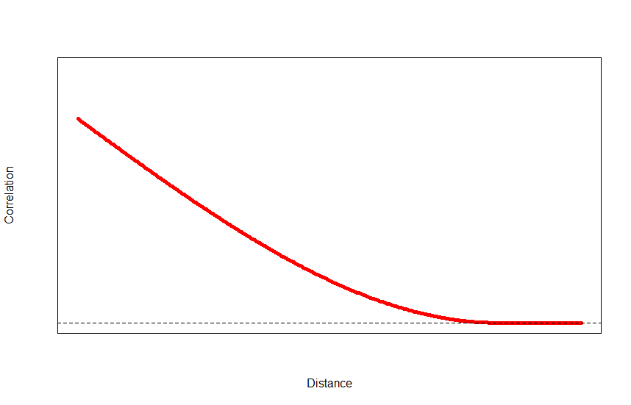
Why is it important to include spatial correlation?
Example 4: fourth reality
1.0
0.8
Correlation
Distance

